Slide 1


Getting Started With Pulling in and Transforming Data in Power BI

Slide 2

KEY OBJECTIVES
To Explain a key Process in Loading Data into Microsoft Power BI
To Show How We Can Load and Transform Data In Microsoft Power BI

Slide 3

Loading Dataset Into Microsoft Power BI
The beauty of Microsoft Power BI lies in its ability to connect to numerous data sources through what is known as "Connectors"
A key process in pulling Data into Microsoft Power BI is The "ETL", Meaning Extract, Transform and Load

Slide 4

Loading Dataset Into Microsoft Power BI
Extract : This Means Pulling Data from Source, which can be from a database, enterprise application, etc.
Transform : It Means cleaning up our datasets to evacuate all the Abnormally, which is Done in the Power Query engine
Load : At this stage cleaned data is loaded Into Microsoft Power BI for further Operations

Slide 5
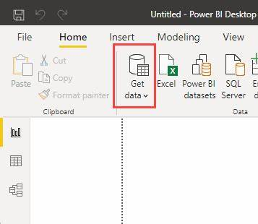
Loading Dataset Into Microsoft Power BI
Steps to get started with loading dataset (CSV)
Click on the Get data in the ribbon under the Home Tab
In the resulting Dropdown, click on the CSV/Text option, this should take you to your file system, where you can select the csv file you want to load
Immediately the file is selected from the file system, it's pushed to the Navigator page, where you can select either to Load directly into Power BI, Transform or cancel the whole process. If you click on load, it takes your data straight up into Microsoft Power BI

Slide 6
Transformation of Dataset In Power Query
From the Previous slides, it can be noted that there are two Possible path into Power BI, Viz: via the "Direct Load Pathway" or "The Transformation Pathway".
The Transformation Pathway leads to the Power Query Engine, where Transformation like what we have below can take place.
We'll be considering some very important transformation that will get us running with cleaning messy Data

Slide 7
Some Common Transformations To get started with
4
1
2
3
4
5
6
1
Renaming Tables(Query)
Renaming Columns
Changing Datatypes
Promoting Headers
Splitting Columns
Removing Columns

Slide 8
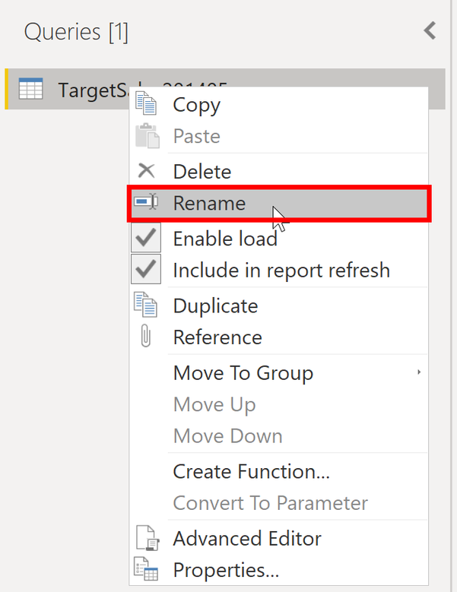
Renaming Tables or Query
Queries can also be referred to as the individual tables pulled out from the various sources they were extracted from, which can be from your personal system, ERP or Company's Databases.
These tables comes with their individual names from their sources, which needs to be consistent, in order to achieve our aim for Analysis
To rename a query, you right click on the query, were you'll see a Drop–down, click on rename to change the name.

Slide 9
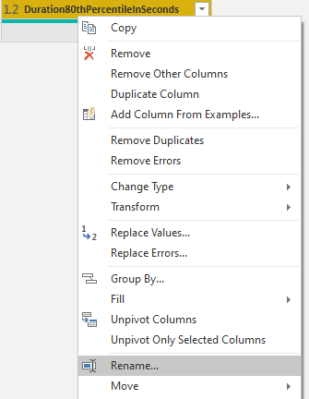
Renaming Columns
Columns fed into the Power query engine may be undesirable, hence the need to rename columns so as to meet the objective of the analysis
To rename a column, right-click on the column header and you'll see rename, click on it to change the name

Slide 10
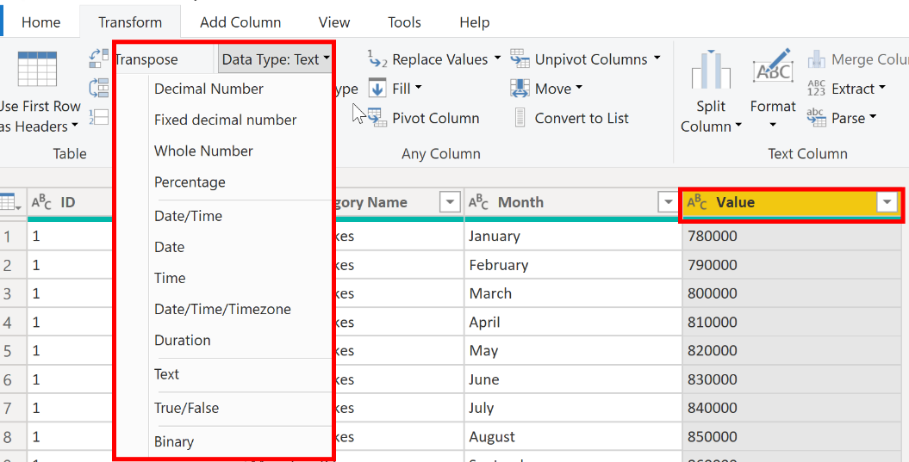
Changing Data Types
This is a key transformation as it determines how Power BI would see your data and also the operations that can be carried out on it
In Power Query to change the Datatype you can either complete it from datatype under the Transform Tab – Alternatively, when you click on the icon that comes before the column name on the column header, you can change to any data type that you want.

Slide 11
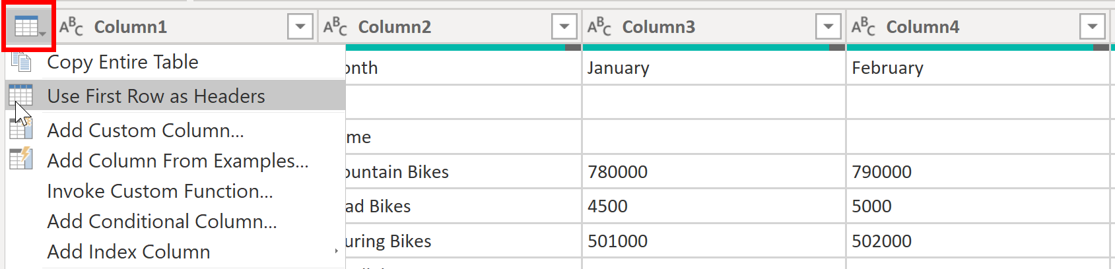
Promoting Headers
Another key transformation that's often associated with csv files is promotion of Headers – due to this continuous need for this, anytime Power query receives a csv file, it automatically moves the first row to the header position (i.e Promotion of Headers)
You can promote headers in two ways: by selecting the Use First Row as Headers option on the Home tab or by selecting the drop-down button next to Column1 and then selecting Use First Row as Headers.

Slide 12
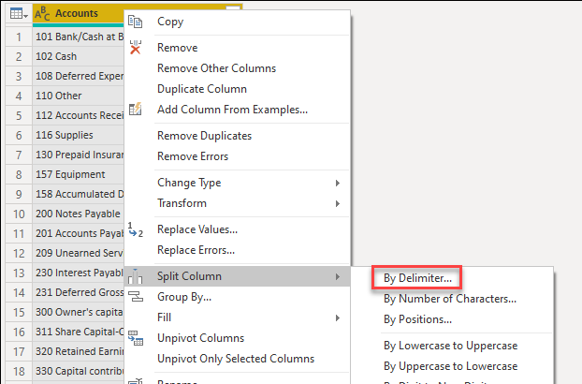
Splitting Columns
Sometimes there may be need to split the data in a column into other columns by a delimiter which can be a space, comma, etc.
To split a column, right-click on that column, you'll see a Drop-down where you'll see split, click on that, and it should take you to the space where you can choose the type of delimiter to use and other options.

Slide 13
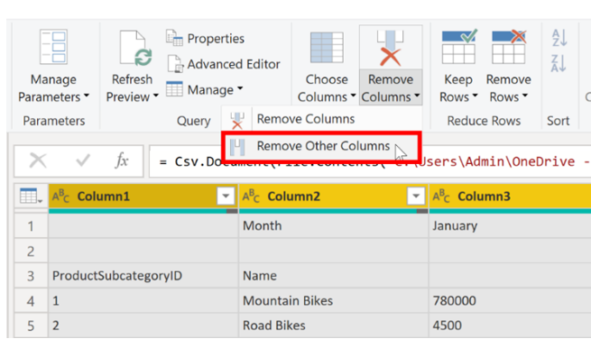
Removing Columns/Removing other Columns
Most times, some columns are not desired and needs to be removed for Performance sake.
There are two options to removing a column: while the remove other columns will remove columns not selected, while the remove columns will remove the selected ones
To remove a column, while on the Home tab, select the Column that you want to remove and then click on remove column.

Slide 14
Conclusion
It is important to know that data transformation is key to the quality of results gotten, hence the need to be thorough as results will be used by key stakeholders of organizations. Hence, a little mistake may be transmitting to a loss in revenue

Slide 15


Thanks for your Rapt Attention

